Slide 1
Stack Overflow’s 2019 Developer Survey Analysis
By Alexia Harris, Hailey Gibson, and Deven Lockett
Notes:
Good Afternoon, this is our analysis of the 2019 annual developer survey. Stack Overflow conducts an annual survey of people who code around the world. Each year they field a survey covering everything from developers’ favorite technologies to their job preferences.

Slide 2
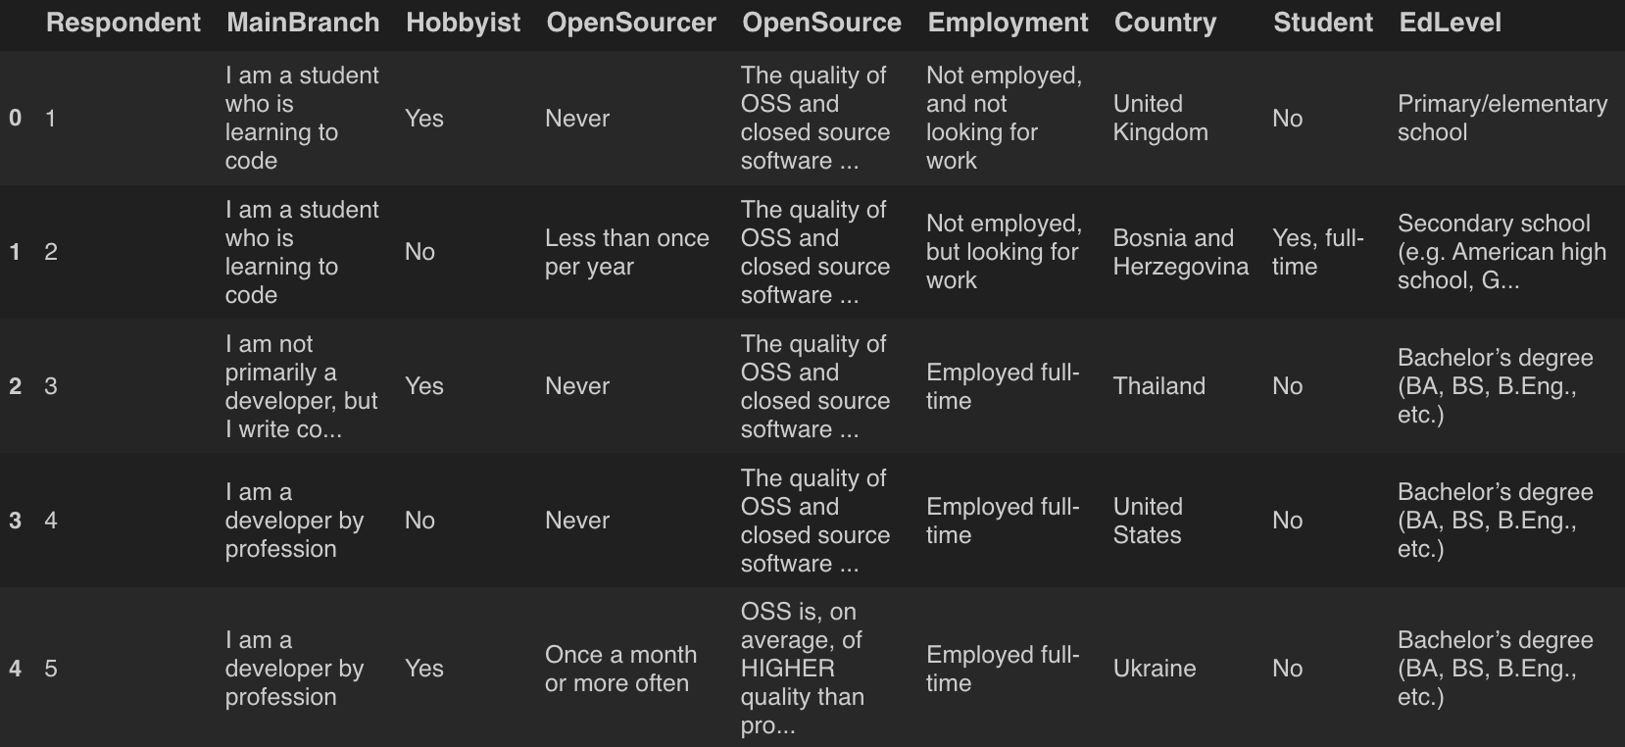
DataFrame
This shows five rows, and 9 columns
The DataFrame has 88883 rows, and 85 columns total
Notes:
This table displays a small subset of the data. This subset showcases five rows, and 9 columns. While the Dataframe has 88,883 rows and 85 columns total. This displays the respondent’s responses to each of the survey’s questions.

Slide 3
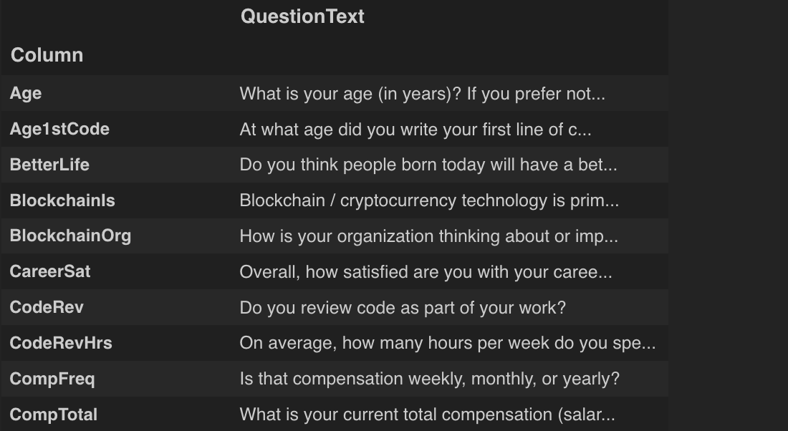
Schema DataFrame
This Dataframe is used to help understand the columns of the original Dataframe
ex) “Hobbyist” corresponds to the survey question “Do you code as a hobby?”
This shows 10 rows, and 1 columns
The Schema DataFrame has 85 rows, and 1 columns total
Notes:
Next we have the schema dataframe. This acts kinda as a key for the first data frame. For example there is a column labeled “Hobbyist” in the original dataframe. Without the schema DataFrame what this column is trying to tell us would be unclear, however with it we know the respondent is answering the question, “Do you code as a hobby?”.

Slide 4
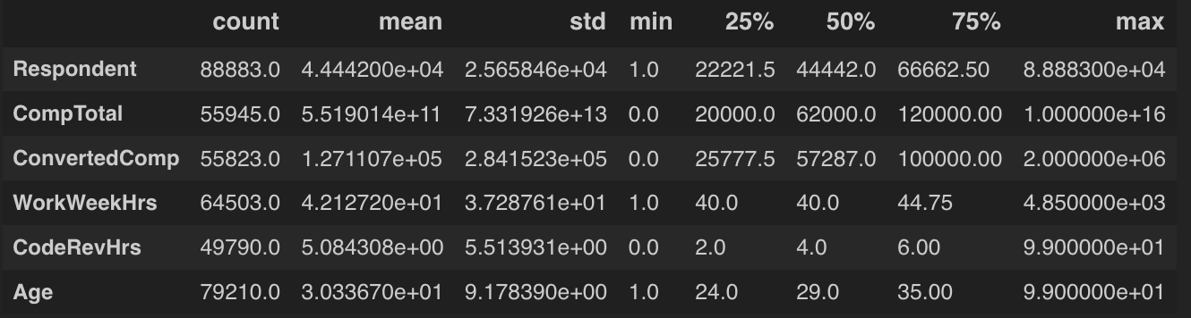
Summary Statistics of DataFrame
Notes:
This table displays the summary statistics of the DataFrame. It displays the count, mean, standard deviation, minimum, 25th quartile, 50th quartile, and 75th quartile, and the maximum value for different features within the DataFrame.

Slide 5
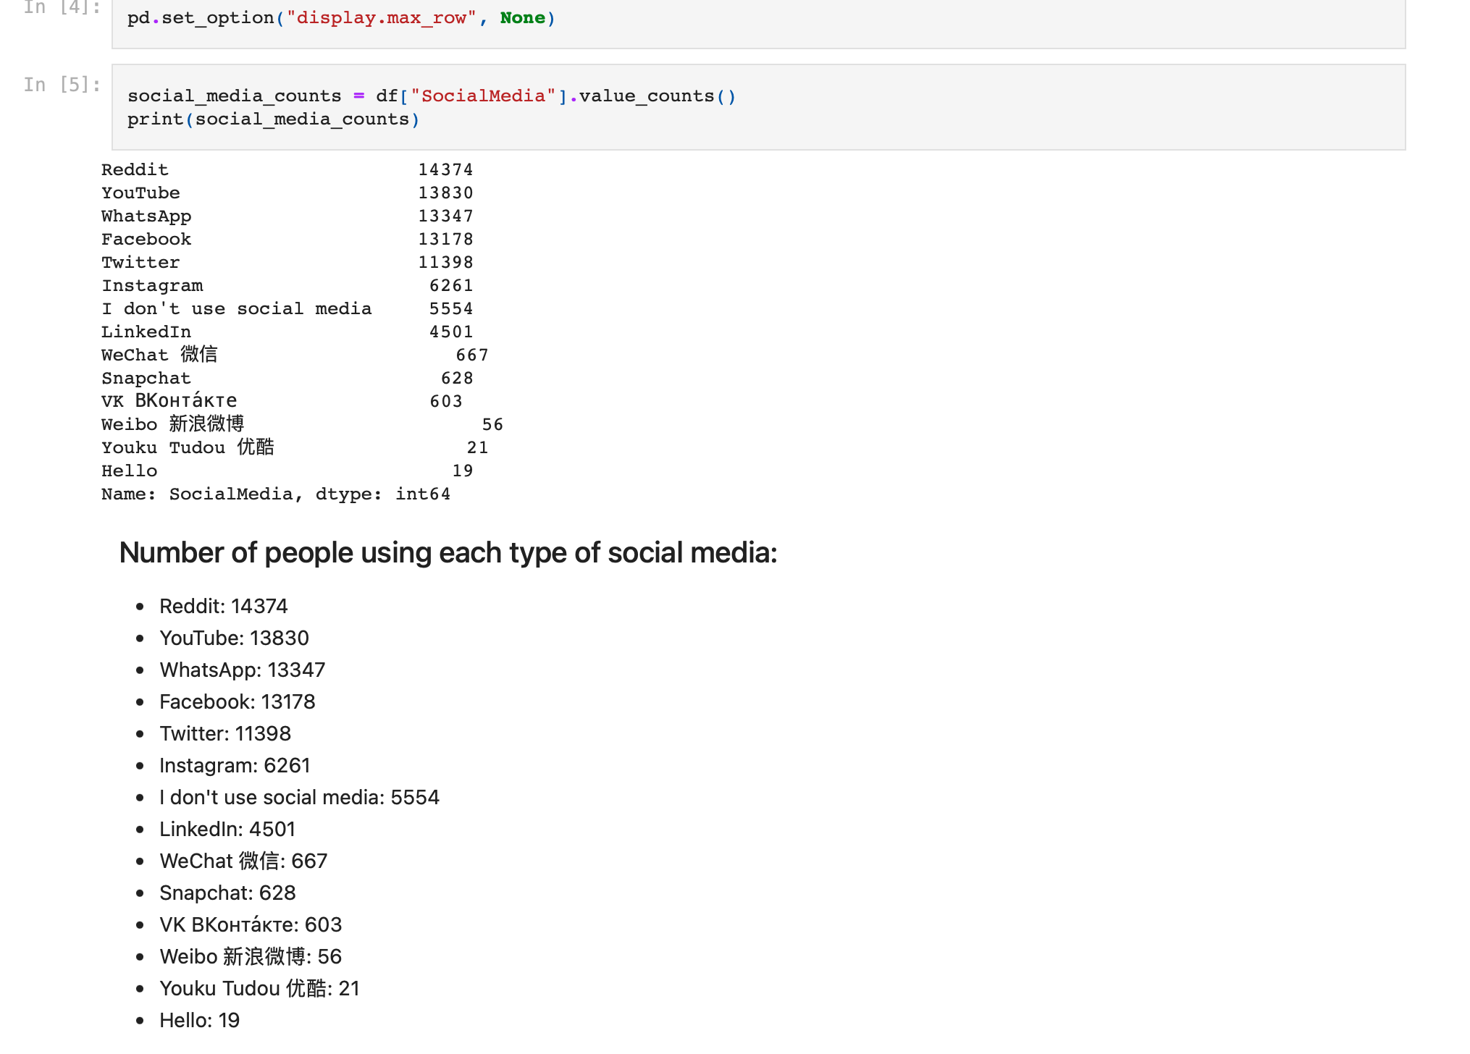
Number of People Using Each Type of Social Media
Notes:
The Pd.set_option function puts the data into rows
Social_media_counts gives us the values for the number of people using each type of social media
Print allows us to actually see the code

Slide 6
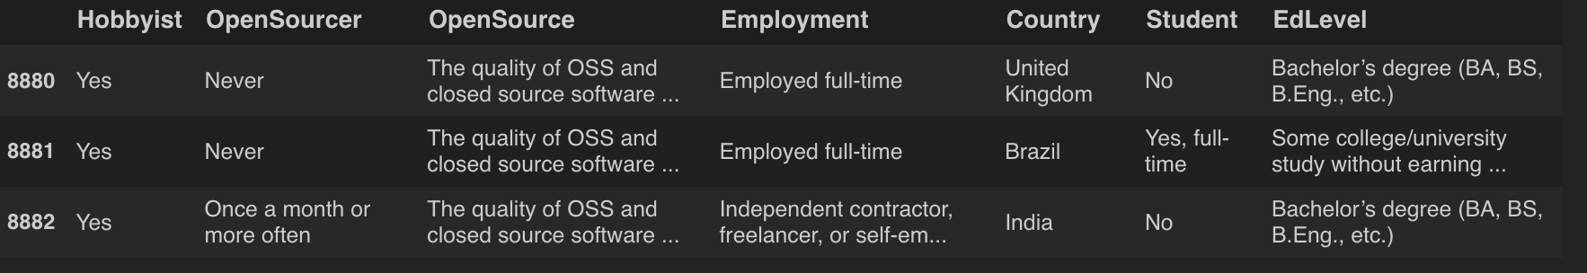
Slice of DataFrame: Looking at a Specific List of Columns
Row 8880 through row 8882
Columns = [“Hobbyist”, “OpenSourcer”, “Employment”, “Country”, “Student”, “EdLevel”]

Slide 7
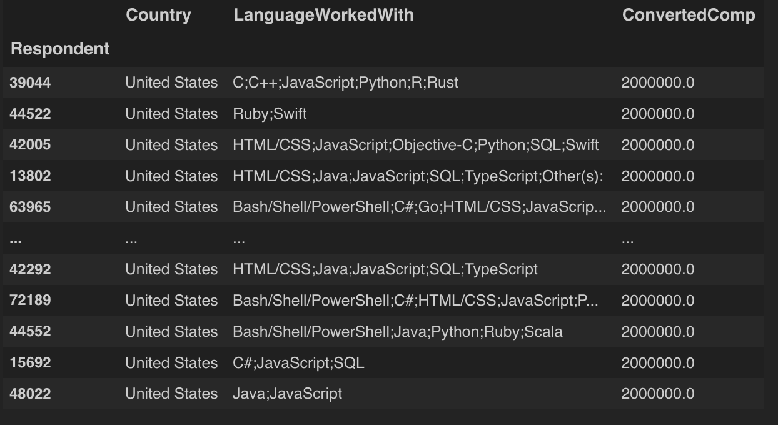
Filter DataFrame by Salary
Only include rows where ConvertedComp is greater than 7000
There are 100 instances in this filter

Slide 8
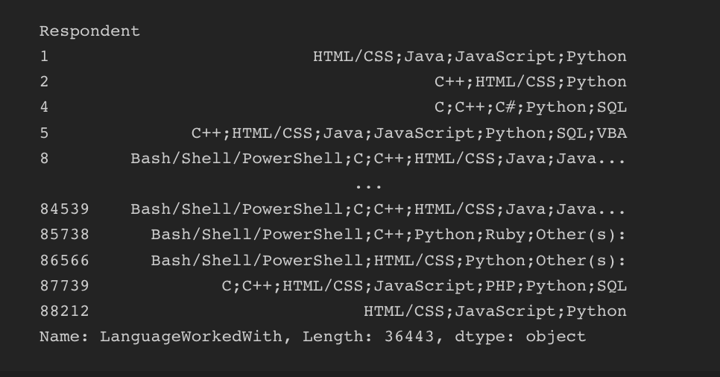
Respondents who worked with Python
36443 Respondents have worked with Python

Slide 9
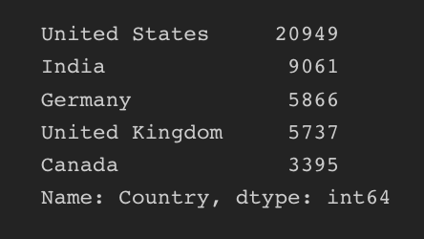
Number of Respondents from a List of Countries
["United States", "India", "Germany", "United Kingdom", "Canada"]

Slide 10
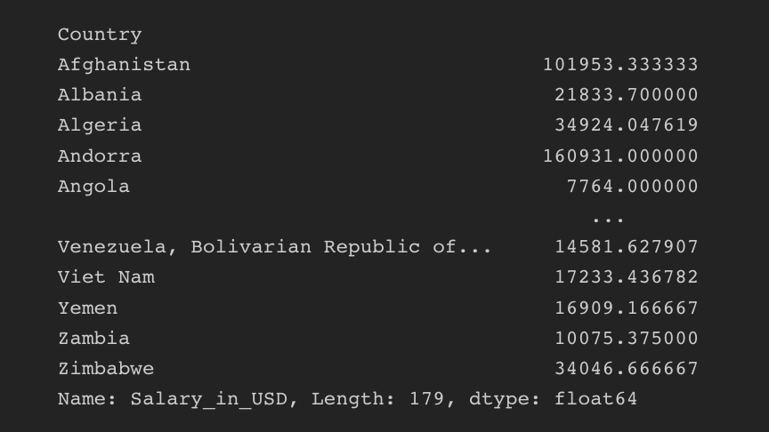
Mean Salary in USD for each Country

Slide 11
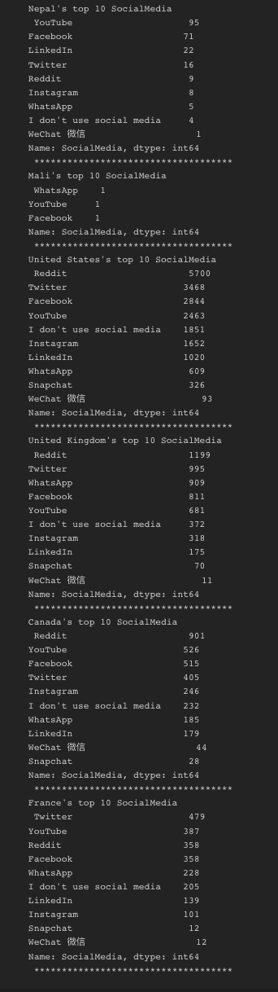
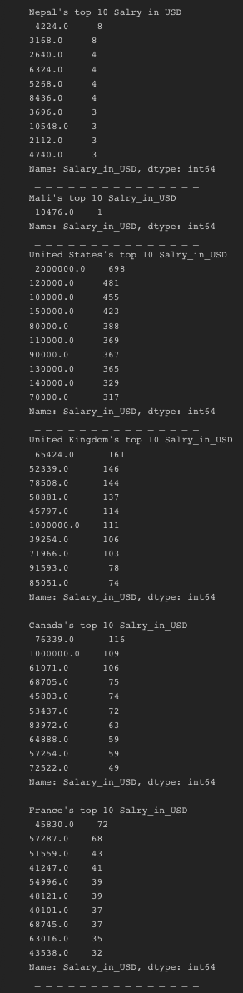
Top 10
Salary in USD
Social Media

Slide 12
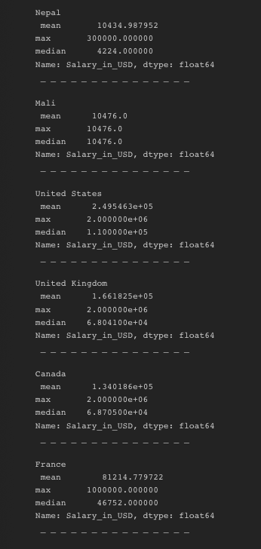
Summary Statistics for a list

Slide 13
Thank You For Listening!

